Slide 1

Verification EvaP
Hardly any algorithms
All logical design bound to huge data models
Only ASA useful (unused imports/variables, unresolved functions, code style, …) Mostly pessimistic inaccuracy
Python

Slide 2
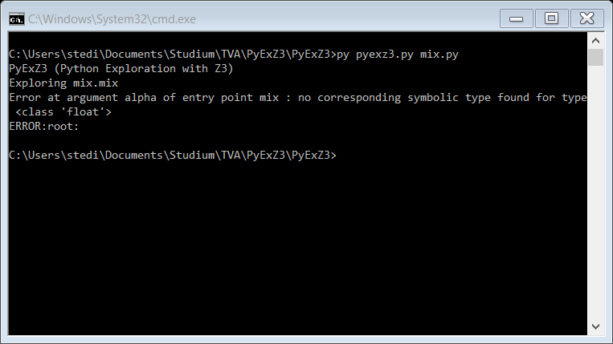
Verification EvaP
PyExZ3
Z3 Theorem prover (Microsoft Research)
Find all paths through a function

